Slide 1
The Institute of Astronomy
(what a Ph.D student gets)
Paul Hewett
Director of Postgraduate Education

Slide 2
Talk overview
The Institute of Astronomy
Ph.D. application timeline
Selection of Overseas-fee students
Selection of Home-fee students
Numbers for applications and scholarship funding
The M.Phil. [by research] programme

Slide 4
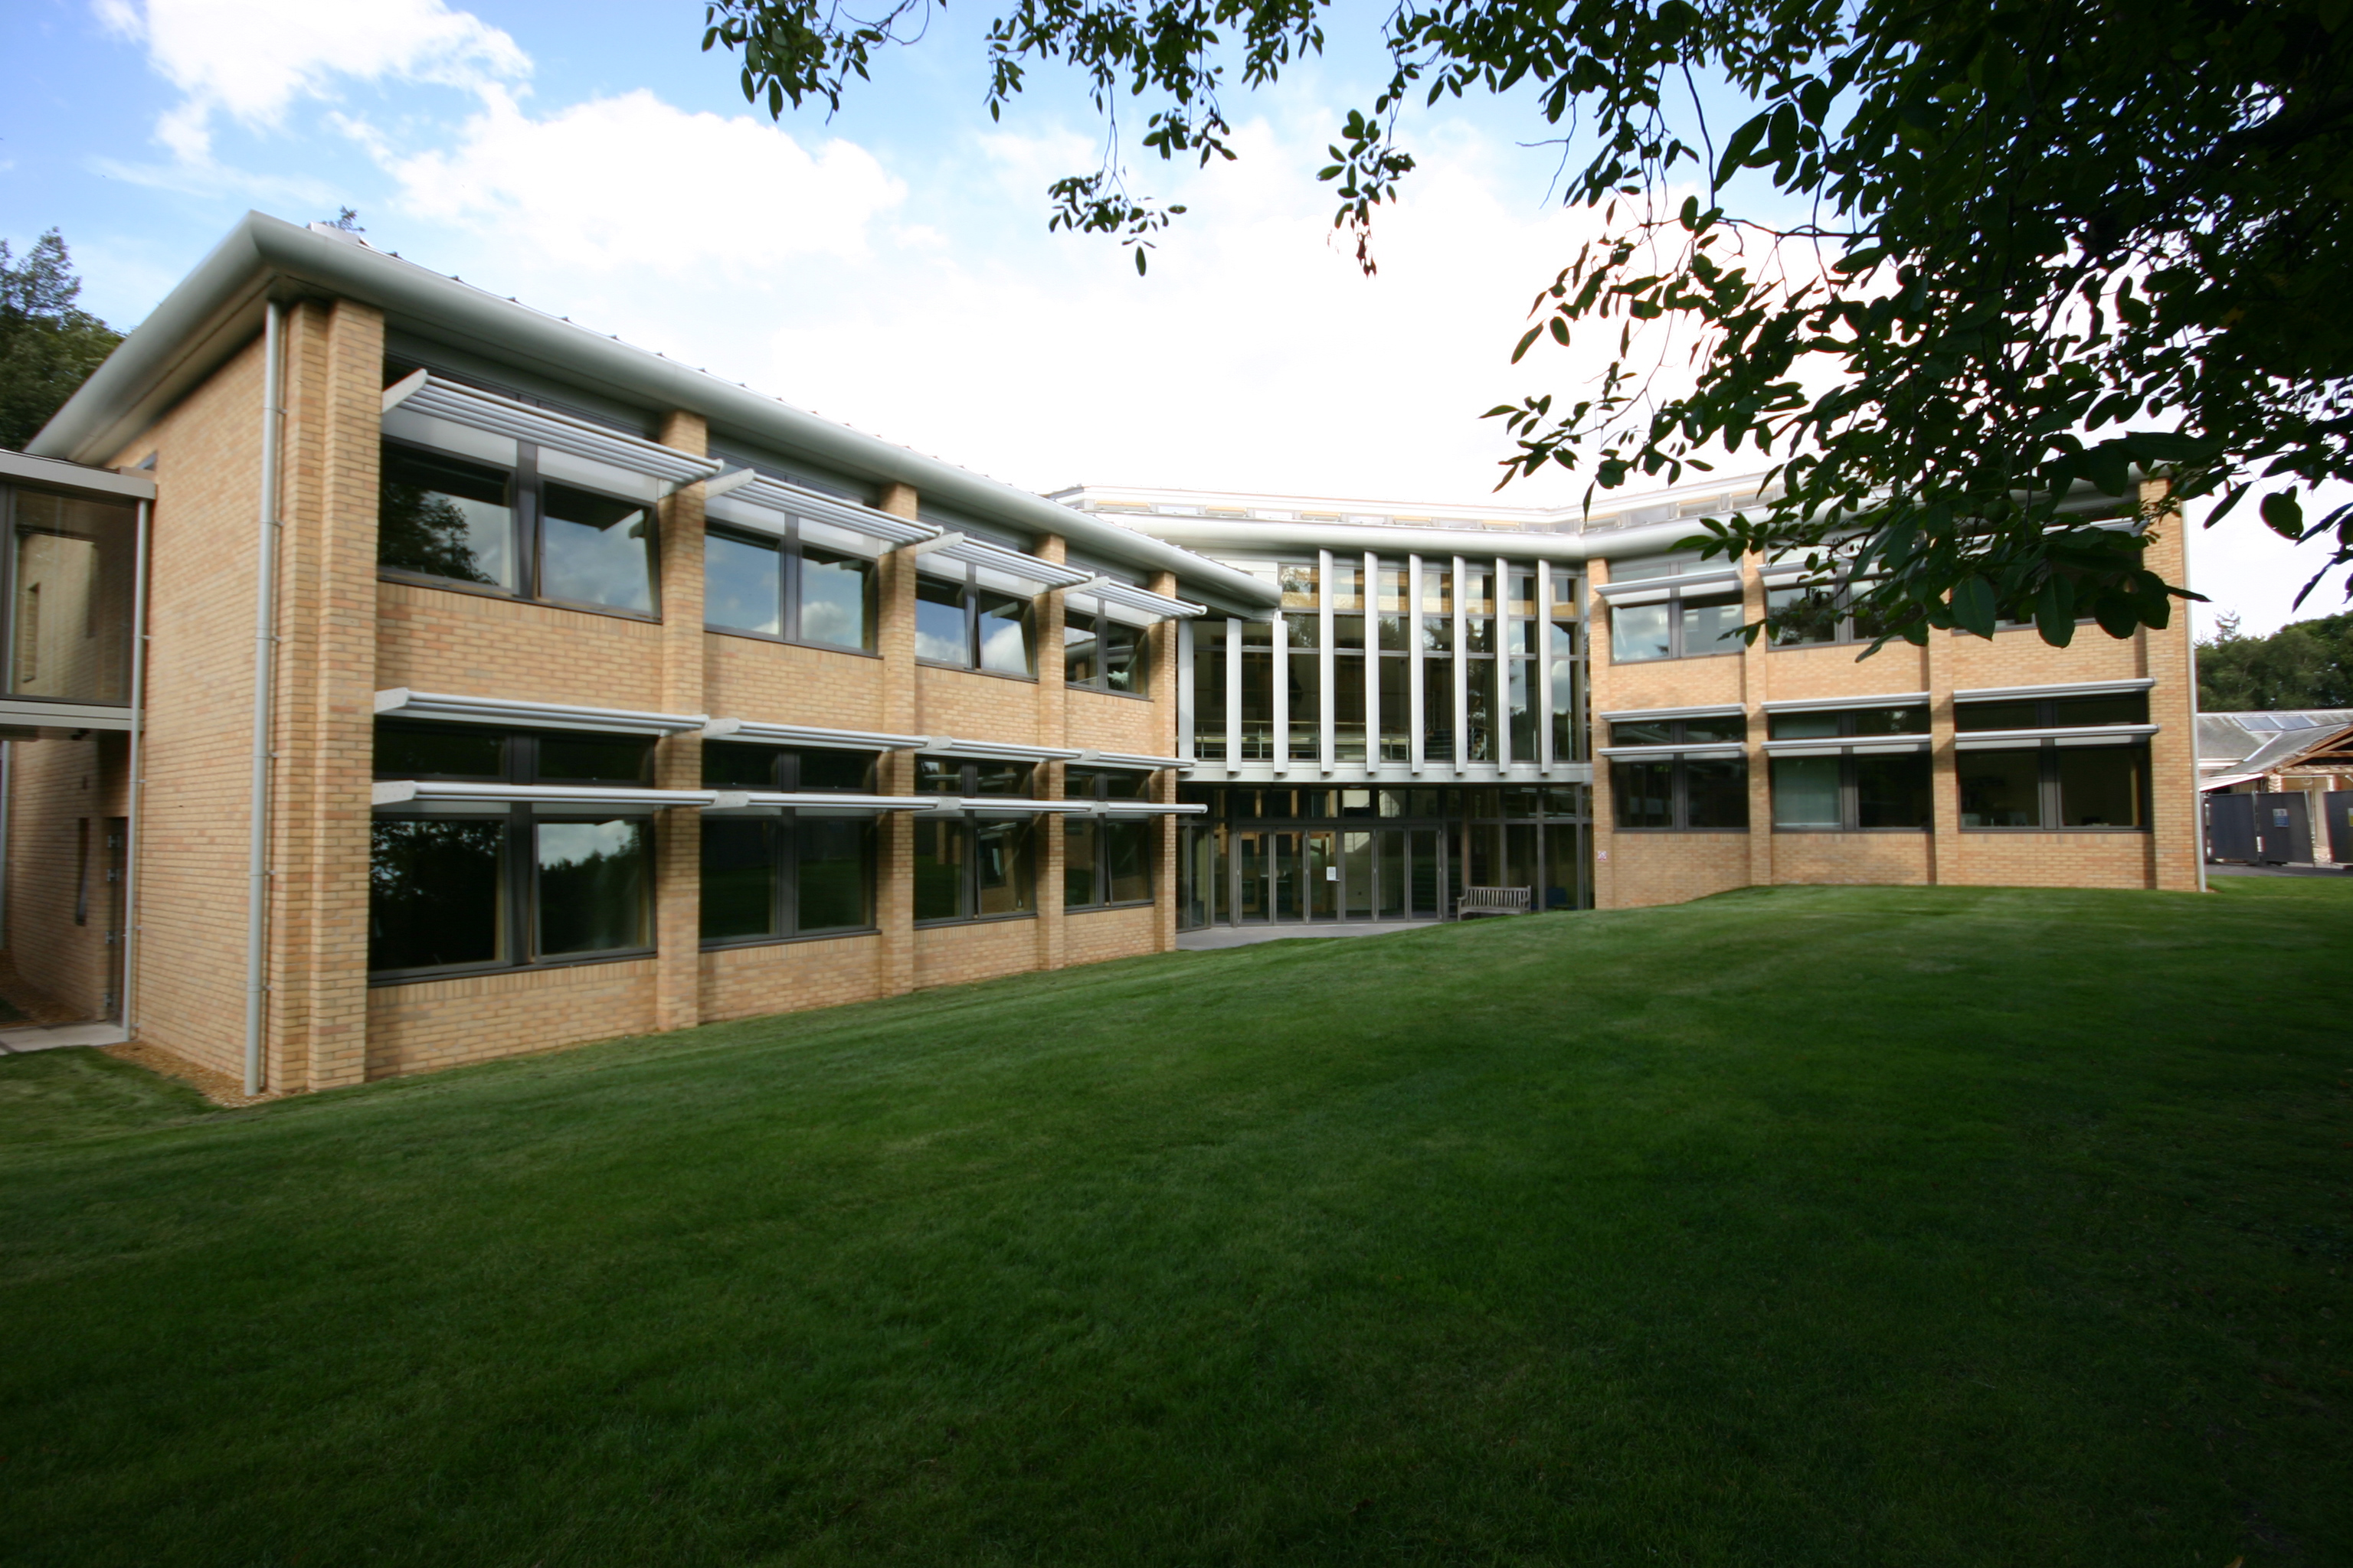

Slide 5
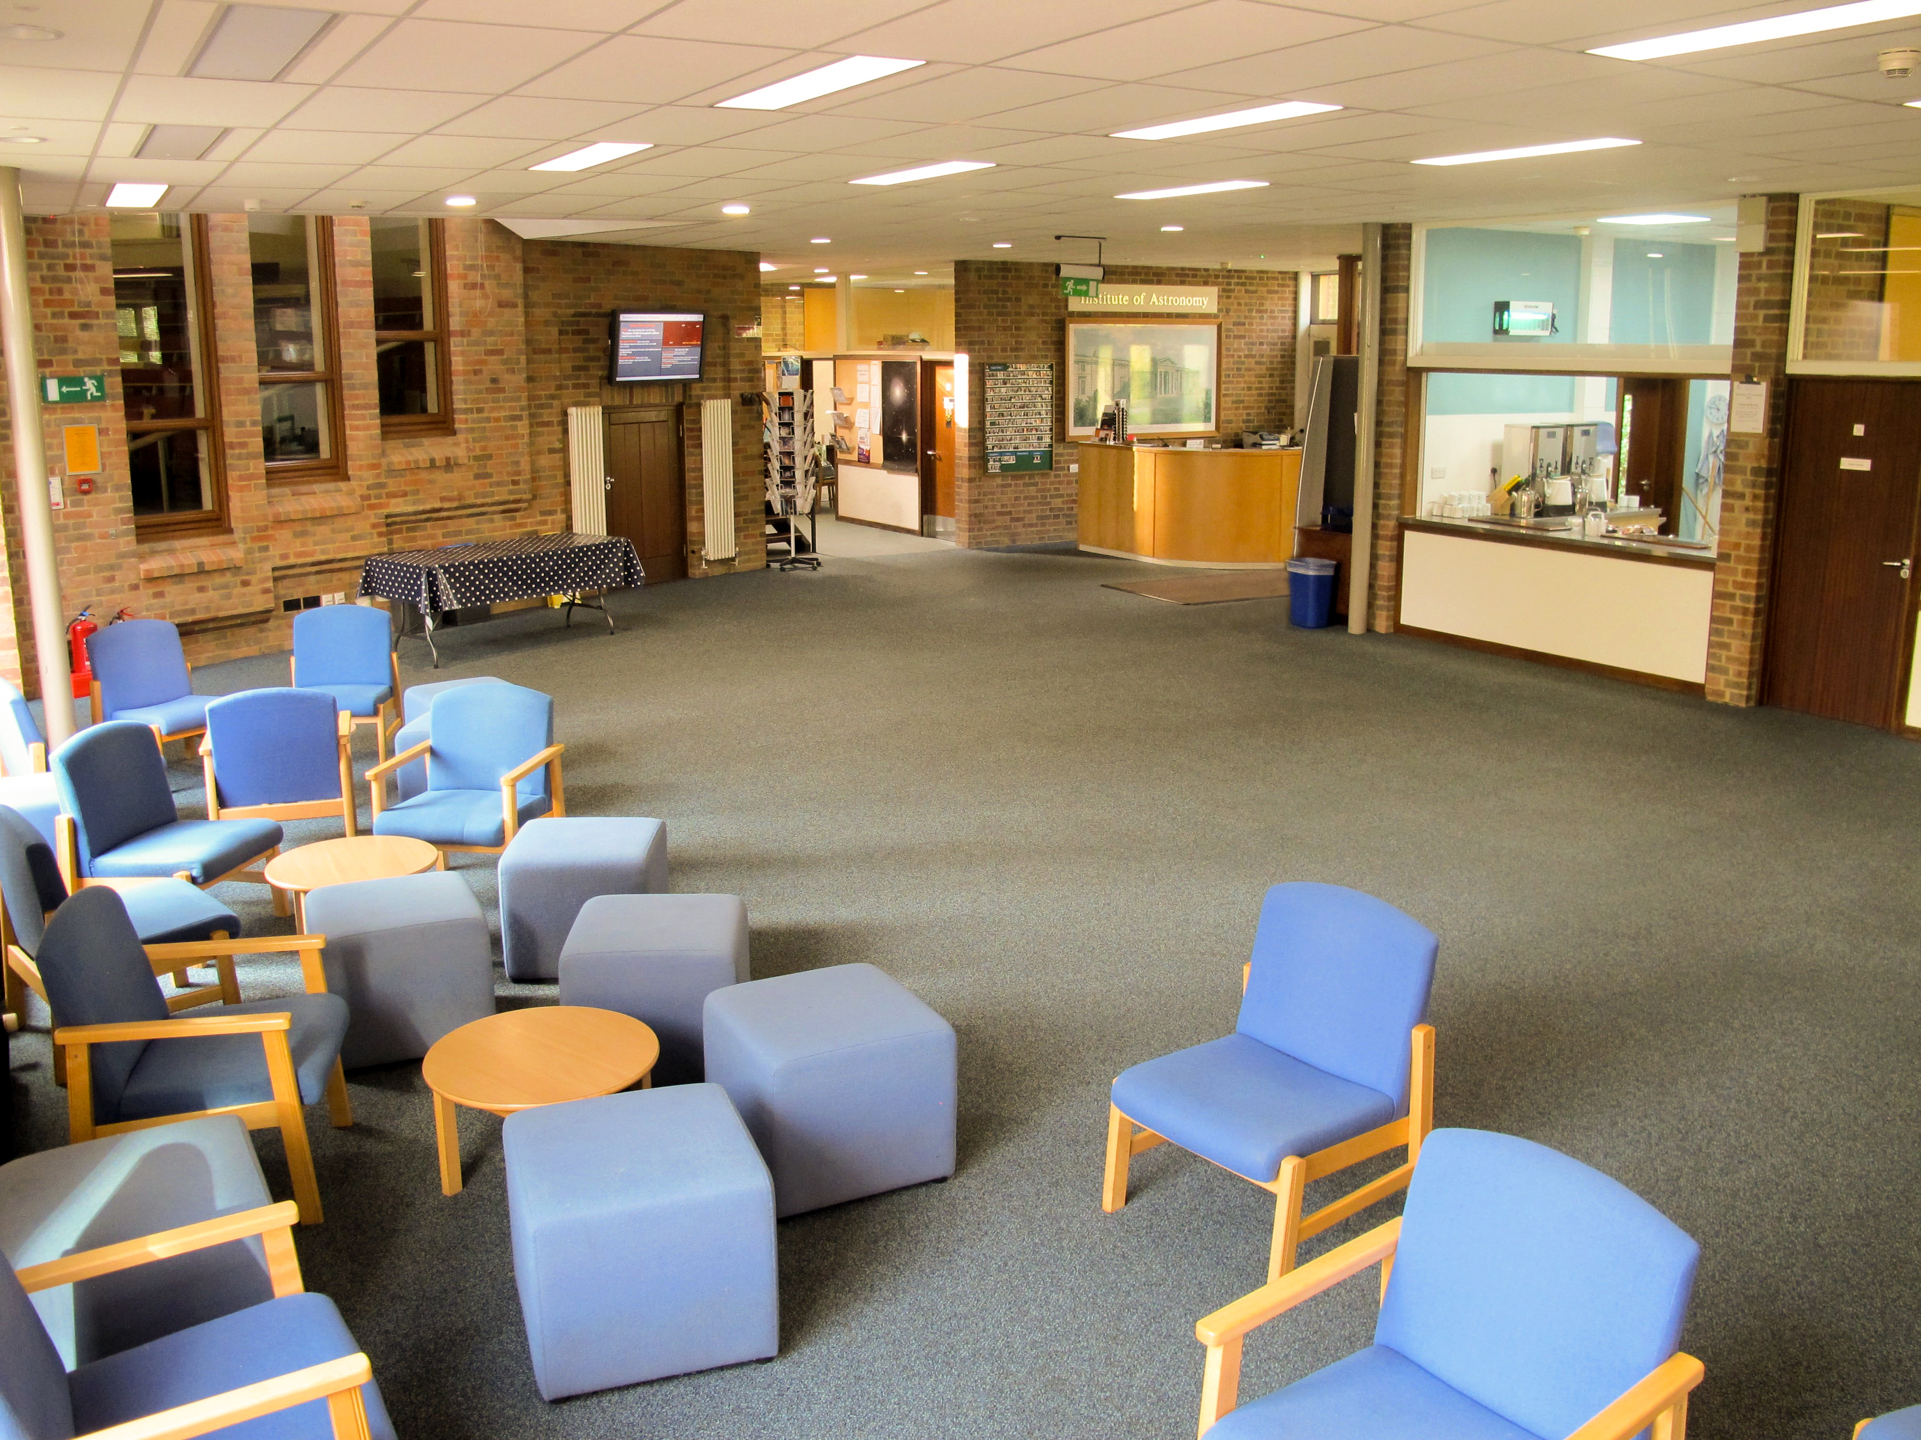

Slide 6
People
18 Academic Staff – 5 cross-appointed
~70 Research Fellows + Postdoctoral researchers
~10 (active) emeritus staff / long-term visitors
~30 Professional Services Staff
~45 postgraduate (Ph.D.) students
~35 Part III/MASt students

Slide 7
Research Range
Theory – numerical simulations - data-intensive research - Observation
Vast topic range on offer:
Exo-planet atmospheres → Cosmic Microwave Background
Huge scale and approach differences:
Major “Projects” e.g. Planck, Gaia, DESI,… with hundreds of collaborators
Individual researchers + Ph.D.
IoA produces ~400 papers per year

Slide 8
Students projects and supervisors
~20 potential Ph.D. Supervisors
~ 40 (or more) potential projects
About 12 new Ph.D. Students
Supervisor/project rich : student poor
Institute website “Students” button, then “Ph.D. programme” contains all the information about applications

Slide 9
Ph.D. 2024 admissions timetable
Institute of Astronomy application deadline
5 December 2023 – for all applications
Not sensible to leave until the last day
You will likely be disadvantaged if your two (or three for Gates) references are not available on 5 December
Other UK and non-UK universities
Most, but not all, operate on a similar time line. Do not restrict applications to just one university

Slide 10
Ph.D. 2024 admissions
First need to make an academic decision based on information in the University application form
Institute participates in University contextual-information pilot
Provides background information including non-academic circumstances
Information could relate to academic performance
We do need evidence about abilities and match to what the Institute provides

Slide 11
Ph.D. 2024 admissions:
Funding scheme depends on fee status
“Home” fee status based on residence in the UK or Ireland plus European Union (EU) nationals with Settled or Pre-settled status under the EU Settlement Scheme (EUSS)
In practice scholarship funding options different for Home- and Overseas-fee applicants
UK Government Visa conditions
Scholarship funding and January timescale for Overseas-
Residents of Ireland are Home-fee and also able to access scholarship funding from all sources

Slide 12
Ph.D. 2024 admissions – Overseas-fee
Post-submission process from 5 December
Academic record
“Statement of Interests” section information
Availability of supervisors in research area(s)
Most promising applicants contacted by potential supervisor(s)
Generate a project description
Project- and supervisor-match mandatory (UK Immigration and University conditions)
Interview with Admissions Committee

Slide 13
Ph.D. 2024 admissions – Overseas-fee
Post-submission process from 5 December
Strongest students (both for supervisor and Admission Committee) ranked according to University scoring system
Top-scoring students nominated for University, Trust scholarships, Gates,…
All completed by end of January 2024
One or two students allocated a Science and Technology Facilities Council (STFC) fully funded award
Note that the admission decision is separate from the funding decision (other than STFC)
Main scholarship sources – Trust, University, Gates

Slide 14
Ph.D. 2024 admissions – Overseas-fee
Timescales for scholarship funding
First STFC offers at end February
Possible further offers by end of March
Cambridge Trust and University – a few offers February / early March
Most in March or April
Gates – end of March
Unfortunately, more accepted students than scholarships
Small probability of an award late April through June

Slide 15
Ph.D. 2024 admissions – Home-fee
Not obvious that Ph.D. choice related to topic of your final year project (or best lecture course) is optimal
Taking time to identify the right project / supervisor / work methodology is really worthwhile
Normally, for Home-fee students we do not match students to project/supervisor on admission
Students encouraged to spend first term exploring research topic, style, supervisors to identify a good match
Possible because of STFC awards and no UK Government immigration issues

Slide 16
Ph.D. 2024 admissions – Home-fee
Funding
Will be assessed, as Overseas-fee students, for nomination to University / Trust scholarships at end January BUT
Prospect of success very small
Realistically, for Home-fee applicants – selection for interview (26 February - 1 March) based on academic record, references, statement of interests
Offers of STFC Ph.D. places made following interviews at end of February
STFC deadline for acceptance end March but we hope decisions by you earlier

Slide 17
Ph.D. 2024 admissions
Some numbers
Applications ~50 Overseas- and ~50 Home-fee (but just an estimate)
Typical number of University/Trust/Gates/STFC scholarships for Overseas-fee applicants - 5
Likely number of STFC and STFC data-science awards for Home-fee students - 6
STFC offers (Home and Overseas) at end February
University/Trust/Gates scholarships from late March through April (we will try and move a few offers earlier)

Slide 18
Ph.D. 2024 admissions
Competition for scholarships from the University, Trust, Gates Colleges is extreme
To be competitive for University…College scholarships you will need
An extremely impressive academic record
Two very strong academic references of some length
Research experience outside of your academic course
Providing you tick the “apply for funding” box on the University application form you will be considered for all sources of scholarship funding associated with astronomy automatically

Slide 19
M.Phil. 2024 admissions
There is an M.Phil. by research degree
In practice a ~10 month duration degree most like a “mini”-Ph.D.
Very few students. Essentially all from USA universities with a scholarship (e.g. Churchill) who take-up the M.Phil. place in between their undergraduate and Ph.D. studies in the USA
Not suited for UK- or European-educated students intending to obtain a Ph.D. in astrophysics or a career in academia
Information on the website. If you really think could be for you – e-mail us

Slide 21
Thank you for listening
www.postgraduate.study.cam.ac.uk Institute of Astronomy admissions@ast.cam.ac.uk

